Slide 1


Slide 2
Lecture 2: OS Concepts
Prof. Seyed Majid Zahedi
https://ece.uwaterloo.ca/~smzahedi

Slide 3
Outline
Brief history of OSes
Four fundamental OS concepts
Thread
Address space
Process
Dual-mode operation/protection

Slide 4
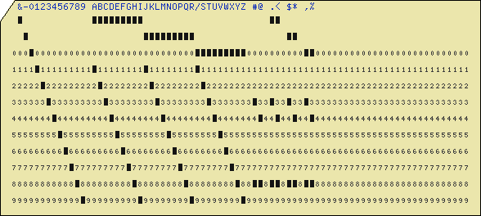
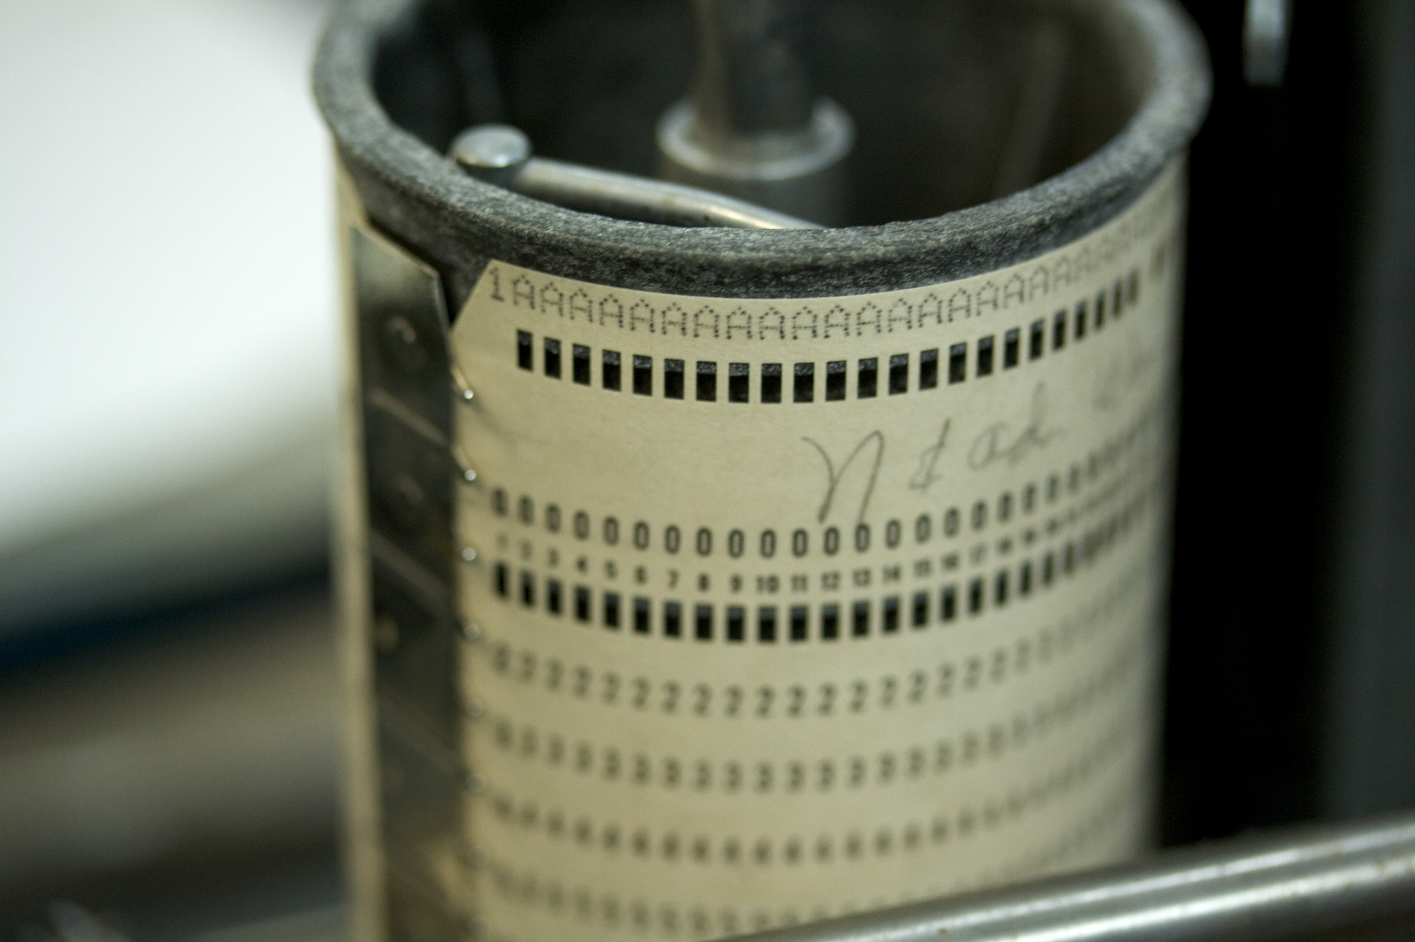
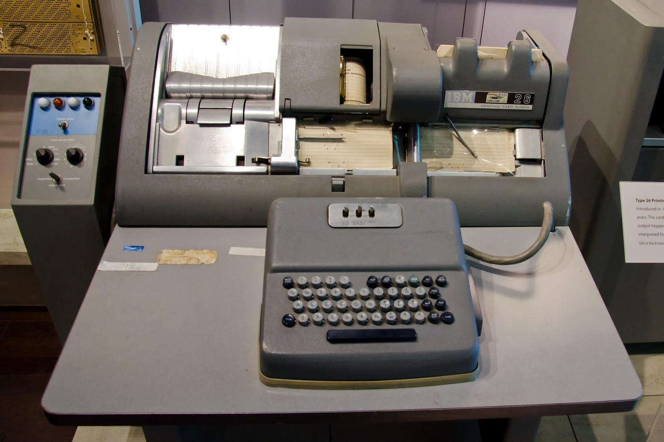
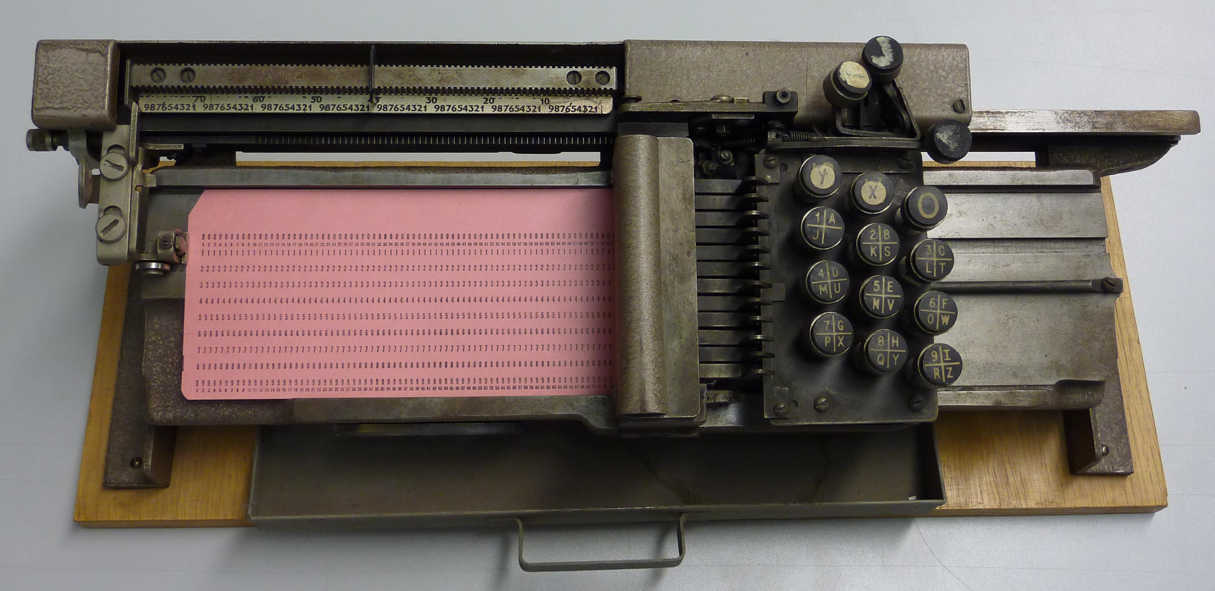
Serial Processing
Machines did not have operating systems
Run from console with display lights, toggle switches, input device, and printer
Machine is used by a single user (users had to reserve time to use machines)
Running programs had long lead time (users had to load compiler and source program, save compiled program, and then load and link it)
Debugging programs was extremely hard
wikimedia.org
columbia.edu

Slide 5
Evolution of OSes
Simple batch OS
Jobs with same requirement and grouped into batches
Special program, called monitor, monitors and manages each program
Erroneous or misbehaving jobs could corrupt entire system
Automatic job sequencing improves throughput, but I/O is still slow
Multiprogramming batch OS
When running job requires I/O, OS switches to another job
While this maximizes CPU utilization, response time could still suffer
Time-sharing OS
Multiple users simultaneously access system through terminals
Processor’s time is shared among multiple users
Primary focus is to minimize response time

Slide 6
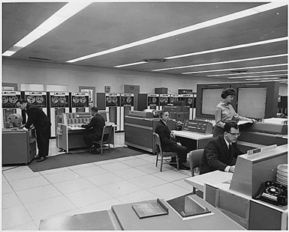
Very Brief History of OS
Several distinct phases:
Hardware expensive, humans cheap
Eniac, … Multics
“I think there is a world market for maybe five computers.” – Thomas Watson, chairman of IBM, 1943
Thomas Watson was often called “the worlds greatest salesman” by the time of his death in 1956
Notes:
Gone from people serving computers to computers serving people.
Except for the odd outlier like Pleo, that people need to take care of, virtually feed and play with.

Slide 7
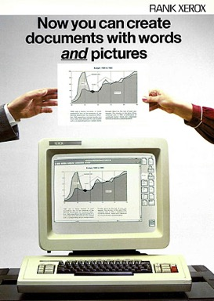

Very Brief History of OS (cont.)
Several distinct phases:
Hardware expensive, humans cheap
Eniac, … Multics
Hardware cheaper, humans expensive
PCs, workstations, rise of GUIs
Hardware very cheap, humans very expensive
Ubiquitous devices, widespread networking
Notes:
Gone from people serving computers to computers serving people.
Except for the odd outlier like Pleo, that people naeed to take care of, virtually feed and play with.

Slide 8
Very Brief History of OS (cont.)
Several distinct phases:
Hardware expensive, humans cheap
Eniac, … Multics
Hardware cheaper, humans expensive
PCs, workstations, rise of GUIs
Hardware very cheap, humans very expensive
Ubiquitous devices, widespread networking
Rapid change in hardware leads to changing OS
Batch ⇒ multiprogramming ⇒ timesharing ⇒ GUI ⇒ ubiquitous devices
Gradual migration of features into smaller machines
Today
Small OS: 100K lines / Large: 20M lines (10M browser!)
100-1000 people-years

Slide 9

OS Archaeology
Due to high cost of building OS from scratch, most modern OS’s have long lineage
Multics ⇒ AT&T Unix ⇒ BSD Unix ⇒ Ultrix, SunOS, NetBSD,…
Mach (micro-kernel) + BSD ⇒ NextStep ⇒ XNU ⇒ Apple OS X, iPhone iOS
MINIX ⇒ Linux ⇒ Android, Chrome OS, RedHat, Ubuntu, Fedora, Debian, Suse,…
CP/M ⇒ QDOS ⇒ MS-DOS ⇒ Windows 3.1 ⇒ NT ⇒ 95 ⇒ 98 ⇒ 2000 ⇒ XP ⇒ Vista ⇒ 7 ⇒ 8 ⇒ 10 ⇒ …
anthropology4u.medium.com
Notes:
Multics: MIT, GE, Bell Labs, 1969
Revolutionary but “bloated” at 135kB
Famous “failures”: Multics, Mach, NextStep: innovative but too flawed to succeed.
Microsoft established itself by writing an OS to compete with CP/M which IBM couldn’t negotiate with its author. They instead bought QDOS from a small code author who had written it from the CP/M manual.
Interestingly, there were some other OSes that didn’t have such a long lineage (e.g. IBM OS/2)

Slide 10
Today: Four Fundamental OS Concepts
Thread
Single unique execution context which fully describes program state
Program counter, registers, execution flags, stack
Address space (with translation)
Address space which is distinct from machine’s physical memory addresses
Process
Instance of executing program consisting of address space and 1+ threads
Dual-mode operation/protection
Only “system” can access certain resources
OS and hardware are protected from user programs
User programs are isolated from one another by controlling translation from program virtual addresses to machine physical addresses

Slide 11
Booting OS
Physical Memory
Disk
(1) BIOS copies bootloader
BIOS
In most x86 systems, BIOS is stored on Boot ROM
Expensive and writing to it is slow
Why not storing kernel on Boot ROM?
Hard to update (OS updates are frequent)
Why does BIOS load bootloader not OS?
Might have multiple OSes installed
BIOS needs to read raw bytes from disk, whereas bootloader needs to know how to read from filesystem
Bootloader instructions and data
Bootloader
(2) Bootloader copies OS kernel
OS kernel instructions and data
OS kernel
Login app
(3) OS kernel copies login application
Login app instructions and data

Slide 12

OS Bottom Line: Run Programs
0xFFF…F
Source Code
Executable Image
Edits
Compiler
OS
learnworthy.net
Data
Instructions
OS Loads
Stack
Load instruction and data segments of executable file into memory
Create stack and heap
“Transfer control to program”
Provide services to program
While protecting OS and program
Heap
Memory
Data
Instructions
OS Starts Execution
0x000…0
PC
Processor Registers

Slide 13
Instruction Cycle: Fetch, Decode, Execute
Memory
Data
ALU
Execution sequence
Fetch instruction at PC
Decode
Execute (possibly using registers)
Write results to registers/memory
PC ← Next(PC)
Repeat
Registers
Decode
Instructions
PC
Next
Next instruction or jump to new address …

Slide 14
Thread (1st OS Concept)
Thread is short for thread of execution
Thread of execution is sequence of executable commands that can run on CPU
Threads have some state and store some local variables
Execution state (ready, running, waiting, …)
Saved context when not running
Execution stack
Local variables
…
Multithreaded programs use more than one thread (some of the time)
Program begins with single initial thread (where the main method is)
Threads can be created and destroyed within programs dynamically
Thread 3
Thread 1
Thread 2
Thread 4
Thread 7
Thread 5
Thread 6
Time

Slide 15
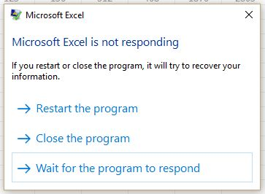
Example: UI Thread
One common way of dividing up program into threads is to separate user interface from other time-consuming actions
If user interface and upload method share the same thread, then once file upload has started, user will not be able to use UI anymore
Not even to click the button that cancels the upload!
UI thread can spawn new thread to handle the upload when user clicks “upload”
UI thread remain responsive as it is not waiting for the upload method to complete

Slide 16
The POSIX Thread
pthread refers to POSIX standard that defines thread behavior in UNIX
pthread_create
Creates new thread to run a function
pthread_exit
Quit thread and clean up, wake up joiner if any
To allow other threads to continue execution, the main thread should terminate by calling pthread_exit() rather than exit(3)
pthread_join
In parent, wait for children to exit, then return
pthread_yield
Relinquish CPU voluntarily
…

Slide 17
Thread Lifecycle
Create
pthread_create
Init
Ready
Scheduled
Running
Finished
Created
Exits
Yields/Suspended
pthread_exit
pthread_yield
Even happens
Waits for event
pthread_exit
pthread_cond_signal/broadcast
pthread_join
pthread_cond_wait
Waiting
A process can go directly from ready or waiting to finished (example: main thread calls exit)

Slide 18
Thread Control Block (TCB)
Data structure in OS containing information needed to manage a thread
Thread unique identifier (tid)
Stack pointer (points to thread's stack in the process)
Program counter (points to the current program instruction of the thread)
State of the thread (e.g., running, ready, waiting, etc.)
Thread's register values
Pointer to process control block (PCB) of the process that the thread lives on (more on this soon)

Slide 19
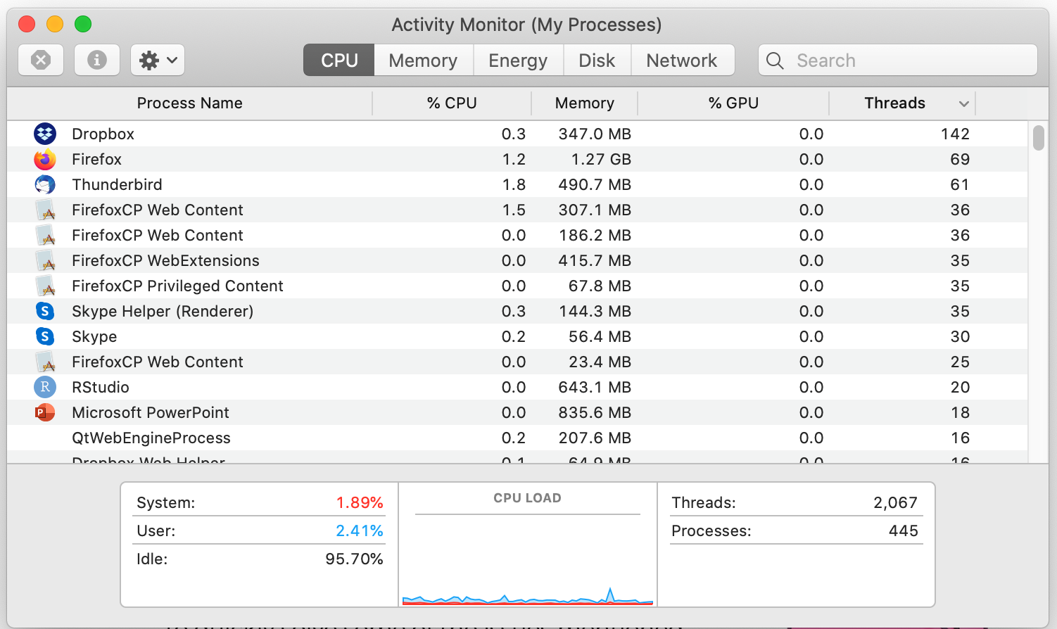
Some Numbers
Many process are multi-threaded, so thread context switches may be either within-process or across-processes

Slide 20
Address Space (2nd OS Concept)
Address space: set of accessible addresses and their state
Physical memory: data storage medium
Physical addresses: addresses available on physical memory
For 4GB of memory: 2³²B ~ 4 billion addresses
Virtual addresses: addresses generated by program
For 64-bit processor: 2⁶⁴ > 18 quintillion (10¹⁸) addresses

Slide 21
Virtual Address Space Layout of C Programs
0xFFFF…F
Command line args and environment vars
#include <stdio.h>
#include <stdlib.h>
int x;
int y = 15;
int main(int argc, char *argv[]) {
int *values;
int I;
values = (int *)malloc(sizeof(int)*5);
for (i = 0; i < 5; i++)
values[i] = i;
return 0;
}
Stack
Shared library
Shared library
Heap
Uninitialized Data
Initialized Data
Binary Code
0x0000…0

Slide 22
Stack Example
Stack Pointer
tmp = 1
ret = ext
A0: A(int tmp) {
A1: if (tmp<2)
A2: B();
A3: printf(tmp);
A4: }
B0: B() {
B1: C();
B2: }
C0: C() {
C1: A(2);
C2: }
A(1);
ext:
Stack holds temporary results
Permits recursive execution
Crucial to modern languages

Slide 23
Stack Example
Stack Pointer
tmp = 1
ret = ext
A0: A(int tmp) {
A1: if (tmp<2)
A2: B();
A3: printf(tmp);
A4: }
B0: B() {
B1: C();
B2: }
C0: C() {
C1: A(2);
C2: }
A(1);
ext:
Stack holds temporary results
Permits recursive execution
Crucial to modern languages

Slide 24
Stack Example
Stack Pointer
tmp = 1
ret = ext
A0: A(int tmp) {
A1: if (tmp<2)
A2: B();
A3: printf(tmp);
A4: }
B0: B() {
B1: C();
B2: }
C0: C() {
C1: A(2);
C2: }
A(1);
ext:
Stack holds temporary results
Permits recursive execution
Crucial to modern languages

Slide 25
Stack Example
tmp = 1
ret = ext
A0: A(int tmp) {
A1: if (tmp<2)
A2: B();
A3: printf(tmp);
A4: }
B0: B() {
B1: C();
B2: }
C0: C() {
C1: A(2);
C2: }
A(1);
ext:
Stack Pointer
ret = A3
Stack holds temporary results
Permits recursive execution
Crucial to modern languages

Slide 26
Stack Example
tmp = 1
ret = ext
A0: A(int tmp) {
A1: if (tmp<2)
A2: B();
A3: printf(tmp);
A4: }
B0: B() {
B1: C();
B2: }
C0: C() {
C1: A(2);
C2: }
A(1);
ext:
ret = A3
Stack Pointer
ret = B2
Stack holds temporary results
Permits recursive execution
Crucial to modern languages

Slide 27
Stack Example
tmp = 1
ret = ext
A0: A(int tmp) {
A1: if (tmp<2)
A2: B();
A3: printf(tmp);
A4: }
B0: B() {
B1: C();
B2: }
C0: C() {
C1: A(2);
C2: }
A(1);
ext:
ret = A3
ret = B2
Stack Pointer
tmp = 2
ret = C2
Stack holds temporary results
Permits recursive execution
Crucial to modern languages

Slide 28
Stack Example
tmp = 1
ret = ext
A0: A(int tmp) {
A1: if (tmp<2)
A2: B();
A3: printf(tmp);
A4: }
B0: B() {
B1: C();
B2: }
C0: C() {
C1: A(2);
C2: }
A(1);
ext:
ret = A3
ret = B2
Stack Pointer
tmp = 2
ret = C2
> 2
Stack holds temporary results
Permits recursive execution
Crucial to modern languages

Slide 29
Stack Example
tmp = 1
ret = ext
A0: A(int tmp) {
A1: if (tmp<2)
A2: B();
A3: printf(tmp);
A4: }
B0: B() {
B1: C();
B2: }
C0: C() {
C1: A(2);
C2: }
A(1);
ext:
ret = A3
ret = B2
Stack Pointer
tmp = 2
ret = C2
> 2
Stack holds temporary results
Permits recursive execution
Crucial to modern languages

Slide 30
Stack Example
tmp = 1
ret = ext
A0: A(int tmp) {
A1: if (tmp<2)
A2: B();
A3: printf(tmp);
A4: }
B0: B() {
B1: C();
B2: }
C0: C() {
C1: A(2);
C2: }
A(1);
ext:
ret = A3
Stack Pointer
ret = B2
> 2
Stack holds temporary results
Permits recursive execution
Crucial to modern languages

Slide 31
Stack Example
tmp = 1
ret = ext
A0: A(int tmp) {
A1: if (tmp<2)
A2: B();
A3: printf(tmp);
A4: }
B0: B() {
B1: C();
B2: }
C0: C() {
C1: A(2);
C2: }
A(1);
ext:
Stack Pointer
ret = A3
> 2
Stack holds temporary results
Permits recursive execution
Crucial to modern languages

Slide 32
Stack Example
Stack Pointer
tmp = 1
ret = ext
A0: A(int tmp) {
A1: if (tmp<2)
A2: B();
A3: printf(tmp);
A4: }
B0: B() {
B1: C();
B2: }
C0: C() {
C1: A(2);
C2: }
A(1);
ext:
> 21
Stack holds temporary results
Permits recursive execution
Crucial to modern languages

Slide 33
Stack Example
Stack Pointer
tmp = 1
ret = ext
A0: A(int tmp) {
A1: if (tmp<2)
A2: B();
A3: printf(tmp);
A4: }
B0: B() {
B1: C();
B2: }
C0: C() {
C1: A(2);
C2: }
A(1);
ext:
> 21
Stack holds temporary results
Permits recursive execution
Crucial to modern languages

Slide 34
Stack Example
A0: A(int tmp) {
A1: if (tmp<2)
A2: B();
A3: printf(tmp);
A4: }
B0: B() {
B1: C();
B2: }
C0: C() {
C1: A(2);
C2: }
A(1);
ext:
> 21
Stack holds temporary results
Permits recursive execution
Crucial to modern languages

Slide 35
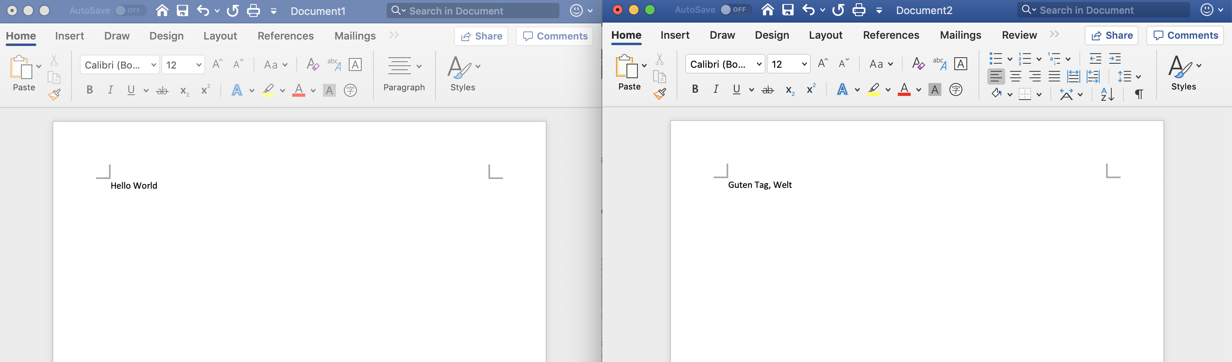
Process (3rd OS Concept)
A process is a program in execution
Two instances of same program running equals two processes
You may have two windows open for Microsoft Word, and even though they are the same program, they are separate processes
Similarly, two users who both use Firefox at the same time on a terminal server are interacting with two different processes

Slide 36
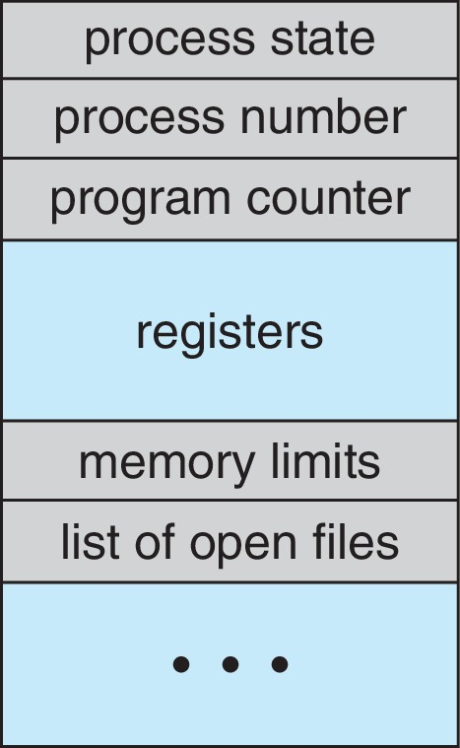
Process Control Block (PCB)
Is a data structure for managing processes
Is created and updated by OS for each running process
Is kept up to date constantly as process executes
Is held in memory and maintained in some container (e.g., list) by kernel
Contains everything OS needs to know about the process
Unique process identifier (PID), state, priority
Program counter (PC)
Register data
Memory pointers
I/O status information,
Accounting information
PC and register data do not need to be updated when program is running
They are needed when a system call (trap) or process switch occurs

Slide 37
PCB During Process Life Cycle
Upon creation, OS creates new PCB for the process
OS initializes data in new PCB
Set variables to their initial values
Set initial program state
Set instruction pointer to first instruction in main
OS then adds PCB to the list of PCBs
After process is terminated and cleaned up, OS removes the PCB from its list of active processes
OS might collect some data before removing PCB (e.g., summary of accounting information)

Slide 38
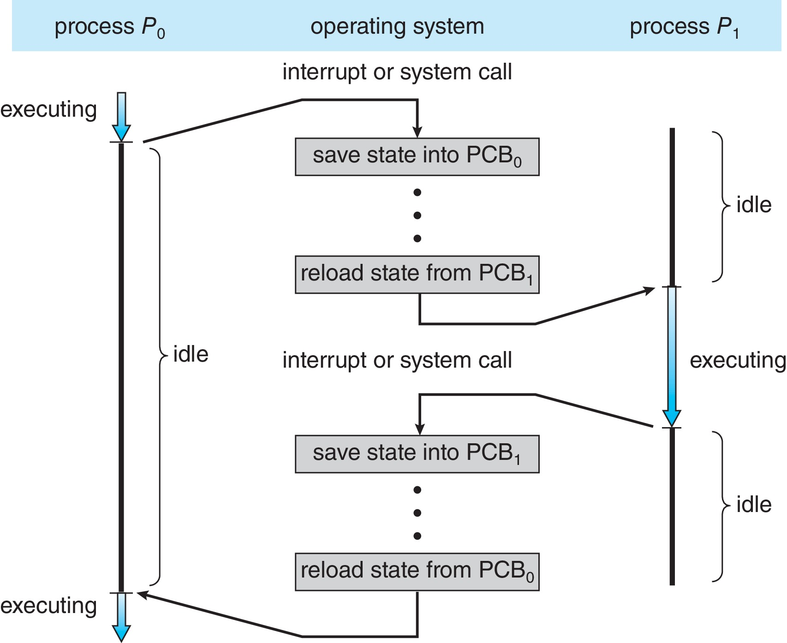
Context Switch: CPU Switch Between Two Processes

Slide 39


Process Creation
System boot up
E.g., login process in Linux
Embedded systems often create all processes they will ever run at bootup
User request
E.g., double clicking on icons
One process spawns another
E.g., clicking on a link in an email makes email process start a web browser
E.g., entering a command, like ls or top, makes shell process start a new process
Programs may beak their work up into different logical parts
To promote parallelism or fault tolerance
Processes, unlike most plants and animals, reproduces asexually
Spawning process is the parent and the one spawned is the child
Each process has one parent and zero or more children
Each process and all its descendants form process group

Slide 40

fork(): Spawning New Process in Unix
fork() creates new process as copy of itself with new PID
Both parent and child continue after fork()
Call to fork can return a value
Positive value means this is the parent
Value is PID of the child
Zero value means this is the child
Negative value means the fork failed
Error! Must be handled somehow
Running in original process
All state of original process duplicated in both parent and child
Memory, file descriptors, etc.
www.fortressofsolitude.co.za

Slide 41
UNIX Process Management
fork()
Syscall to create copy of current process and start it
exec()
Syscall to change program being run by current process
wait()
Syscall to wait for process to finish
signal()
Syscall to send notification to another process (e.g., SIGKILL, SIGINT)
Notes:
UNIX splits creating a process into two steps, each of them a lot simpler.

Slide 42
fork() Example
int pid = fork();
if (pid == 0)
exec(...);
else
wait(pid);
int main(...) {
...
}
exec()
fork()
int pid = fork();
if (pid == 0)
exec(...);
else
wait(pid);
int pid = fork();
if (pid == 0)
exec(...);
else
wait(pid);
wait()
Notes:
How is this used – typically, fork a process, child and parent are now both running the same program. One sets up the child program, and runs exec – becoming the new program
The parent, usually, waits for the child to finish

Slide 43
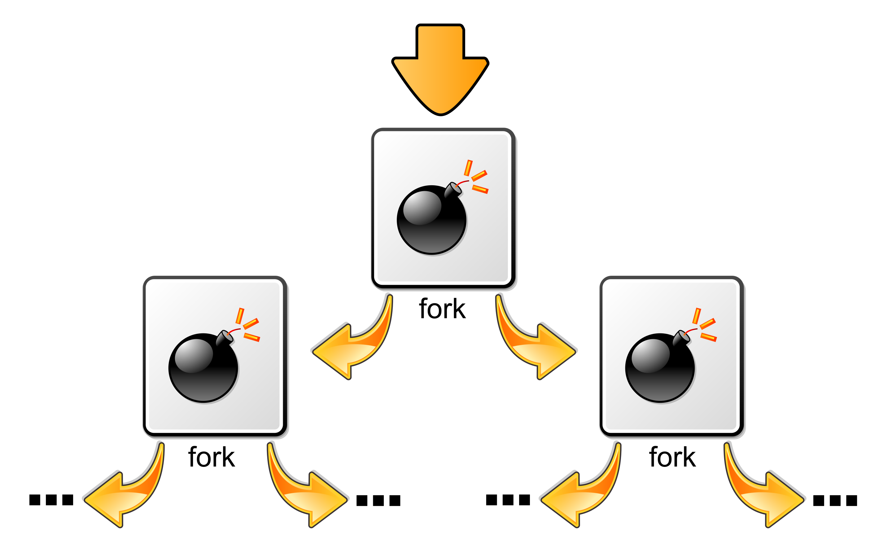
Aside: Fork Bomb
The idea is to call fork repeatedly
Keep doing this until the system crashes (or no work can get done)
Exponential growth (2^{n}) processes after n calls
OS can defend against this
Limit total number of processes per user
Limit rate of process spawning
Note: do not attempt this on University computers
en.wikipedia.org

Slide 44

Process Family Tree in Unix
First process created is called init
Assigned PID of 1
Grandparent of all processes
Like object class in Java which is superclass of all classes
init is replaced by systemd in some newer distributions
Parent of init is swapper (or sched)
Part of kernel and responsible for paging (will come back to this later in the course)
If parent dies before its child, the child becomes orphan
Automatically adopted by init process

Slide 45
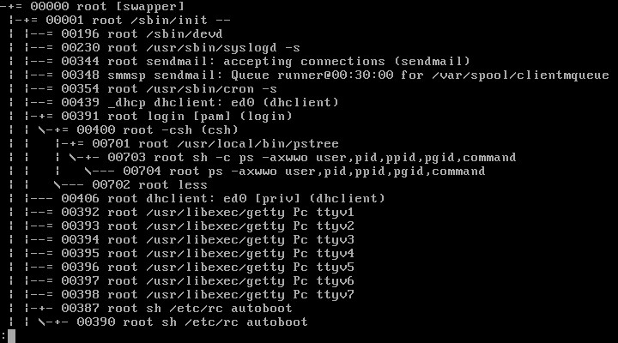
Example: pstree Output in FreeBSD
en.wikipedia.org

Slide 46
Process Destruction
Normal exit (voluntary)
E.g., when compilation is finished, compiler terminates normally
E.g., when you are done editing your document, you click on close button
Error exit (voluntary)
E.g., computer exits with error if you ask it to compile a non-existent file
E.g., process required access to temporary directory, but it didn’t have permission
Fatal error (involuntary)
E.g., division by zero or segmentation fault
OS detects these errors and send it to the program
Processes may tell OS that they wish to handle some of these errors by themselves
If process can handle the error, it continues
Unhandled errors result in involuntary terminations
Killed by another process (involuntary)
Typically, users may only kill processes they have created
Exception: system administrator.

Slide 47
Process Lifecycle (5 States)
Create
Init
Ready
Scheduled
Running
Finished
Created
Exits
Suspended
Unblocked
Blocked
Blocked
A process can go directly from ready or waiting to finished (example: process is killed!)

Slide 48
Processes and Limited Memory
Users often want more processes running than fit in memory
Swapping: when demands for memory exceed available memory, parts of processes will be moved to disk storage to make room
This is extremely expensive
We need to know if a particular process is in memory or on disk
Is adding a new state (e.g., swapped) be enough?
Ideally, we will only swap a process to disk if it is blocked
But what if there are no blocked process?
Or what if the event a swapped process waited for took place?

Slide 49
Process Lifecycle (7 States)
Create
Init
Ready
Scheduled
Running
Finished
Created
Exits
Swapped in
Suspended
Created
Unblocked
Blocked
Ready-Swapped
Swapped out
Blocked
Swapped in
Unblocked
Blocked-Swapped
Swapped out
As in the five state model, there are some omitted transitions to “finished” and one from “running” to “ready-swapped”

Slide 50
Inter-process Communication (IPC)
Shared memory
Normally, each region of memory is associated with one process (its owner)
Processes can designate memory as shared
OS is involved in setting up (and cleaning up) shared memory regions
Shared file
Processes could read/write to/from files in agreed upon locations
OS is still involved in file creation and manipulation
Message passing
Sender gives a message to OS and asks for it to be delivered to recipient
OS is obviously involved

Slide 51
Message Passing
Direct communication
Processes must name each other explicitly
send (P, message) – send a message to process P
receive(Q, message) – receive a message from process Q
Indirect communication
Messages are directed and received from mailboxes (also called ports)
send(M, message) – send a message to mailbox M
receive(M, message) – receive a message from mailbox M

Slide 52
Synchronization
Message passing may be either blocking or non-blocking
Blocking is considered synchronous
Sender is blocked until the message is received
Receiver is blocked until a message is available
Non-blocking is considered asynchronous
Sender sends message and continues
Receiver receives a valid message, or Null message

Slide 53

Signals: Limited Form of Direct IPC
Standardized messages sent to processes to trigger specific behavior
They don’t really contain a message
The fact that signals contain no message is a limitation that means signals cannot be used for every single IPC scenario
imgflip.com

Slide 54
Signals
UNIX systems use signals to indicate events
E.g., the Ctrl-C on the console
It is synchronous if the signal is sent as a result of program execution
E.g., dividing by zero or segmentation fault
It is asynchronous if it comes from outside the process
E.g., user pressing Ctrl-C or one process or thread sending a signal to another
By default, OS handles signals sent to processes with the default handler
Processes could inform OS they are prepared to handle signal themselves
E.g., doing some cleanup when Ctrl-C is received instead of just dying

Slide 55
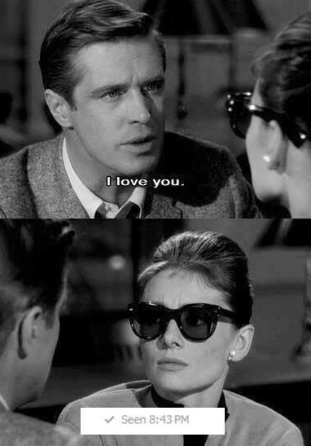
Signals (cont.)
Signals can be sent using command line
E.g., kill -9 24601
-9 parameter sends signal 9 (SIGKILL)
-0 is called the null signal
It does not actually send any signal
Can be used to check if the recipient process exists
Process can block signals
Exceptions are SIGKILL and SIGSTOP
OS doesn’t deliver signal to recipient
Once signal is delivered, recipient can
Ignore it
Run the default action
Run a signal handler
knowyourmeme.com

Slide 56
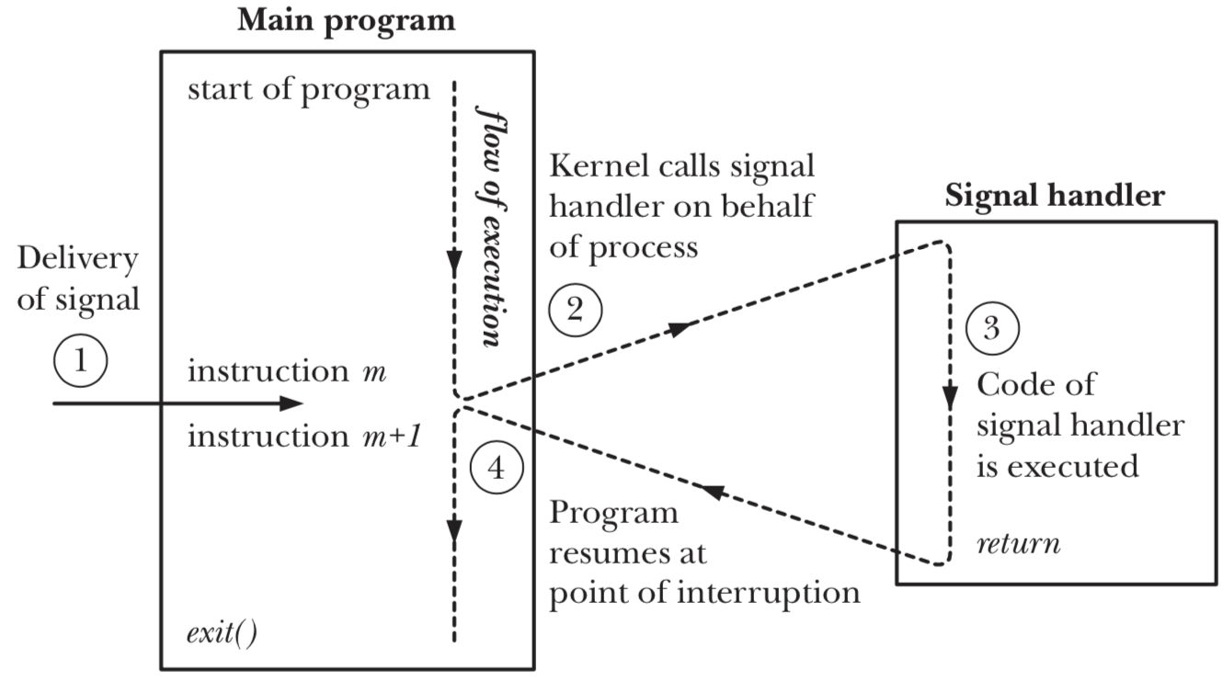
Signal Handler

Slide 57
Signal Handler Example
#include <stdio.h>
#include <stdlib.h>
#include <signal.h>
volatile int quit = 0;
void handle_it (int signal_num) {
quit = 1;
}
int main(int argc, char** argv) {
signal(SIGINT, handle_it);
while(quite == 0){};
printf(“Time to die.\n”);
return 0;
}

Slide 58
Signal Handler: Discussion
Content of signal handler is restricted
Because handler deals with interrupts and runs between two instructions, it is important to make sure that signal handler doesn’t mess anything up
If signal handler runs in the middle of malloc and signal handler itself calls malloc it could put memory management in invalid state
Signal handler can only use functions that are reentrant
There are tables of safe functions to be invoked from within a signal handler.

Slide 59
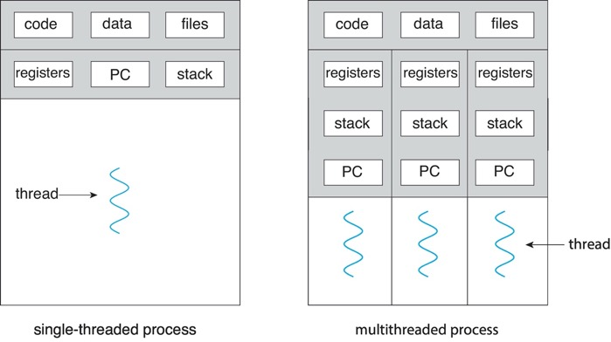
Processes and Threads

Slide 60

Multithreaded Processes
bbci.co.uk
Threads encapsulate concurrency and are active components
Address spaces encapsulate protection and are passive part
Keeps buggy program from trashing system
Why have multiple threads per address space?
Processes are expensive to start, switch between, and communicate between

Slide 61





Example: Web Server
Server must handle many requests
First option is multiprogramming
serverLoop() {
con = AcceptCon();
fork(ServiceWebpage, conn);
}
What are some disadvantages of this technique?
Expensive to start new process
Heavyweight context switch overhead
Notes:
Expensive to start new process, heavyweight context switch overhead (changing address spaces)

Slide 62
Example: Web Server (cont.)
Second option is multithreading
serverLoop() {
con = AcceptCon();
thread_create(ServiceWebpage, conn);
}
Looks almost the same, but has many advantages
Can share file caches kept in memory
Threads are cheaper to create than processes (lower per-request overhead)
What about denial-of-service (DoS) attacks?

Slide 63
Example: Web Server (cont.)
Problem with previous version: unbounded number of threads
When web-site becomes too popular, throughput sinks
Solution: allocate bounded “pool” of threads, representing max level of parallelism
Client
Request
Master Thread
Worker pool
master() { allocThreads(worker, maxLevel); while(TRUE) { con = acceptCon(); enqueue(queue, con);
broadcastToWorkers(); } }
worker(queue) { while(TRUE) { con = dequeue(queue); if (con == null) waitForSignal(); else serviceWebPage(con); } }

Slide 64
Multiple Processes vs. Single Process With Multiple Threads
Fundamental tradeoff between protection and efficiency
Communication harder between processes
This is basically IPC
It necessarily involves OS
Communication easier within a process
All threads of process share state and resources of process
If one thread opens a file, other threads in the process can access it
It does not involve OS

Slide 65
Memory Footprint of Multiple Threads
How do we position stacks relative to each other?
What maximum size should we choose for stacks?
8KB for kernel-level stacks in Linux on x86
Less need for tight space constraint for user-level stacks
What happens if threads violate this?
“… program termination and/or corrupted data”
How might you catch violations?
Place guard values at top and bottom of each stack
Check values on every context switch
Stack 1
Stack 2
Address Space
Heap
Global Data
Code

Slide 66
Multiprogramming: Running Multiple Processes
Physical memory
Proc 1
Proc 2
…
Proc n
Stack
OS
Heap
Data
Code
Stack
Heap
Data
Code
Virtual address spaces
Stack
Heap
Data
Code

Slide 67
Time Sharing: Multiprogramming on Single CPU
Process 1
Process 2
Process 3
Process 1
Process 2
Process 3
Process 1
Process 2
CPU
Time
Illusion: infinite number of processors
Each thread runs on dedicated virtual processor
Reality: few processors, multiple threads running at variable speed
How can we give illusion of infinite number of processors?
Multiplex in time!
How do we switch from one process to next?
Save PC, SP, and registers in current PCB
Load PC, SP, and registers from new PCB
What triggers switch?
Timer, voluntary yield, I/O interrupts, …

Slide 68
How Do We Multiplex Processes?
Scheduling: OS decides which process uses CPU time
Only one process is “running” on each CPU at any time
Scheduler could give more time to important processes
Protection: OS divides non-CPU resources among processes
E.g., give each process their own address space
E.g., multiplex I/O through system calls

Slide 69

Scheduling
Kernel scheduler decides which processes/threads receive CPU
There are variety of scheduling policies for …
Fairness or
Realtime guarantees or
Latency optimization or …
Kernel scheduler maintains data structure containing PCBs
if (readyProcesses(PCBs)) {
nextPCB = selectProcess(PCBs);
run(nextPCB);
} else {
run_idle_process();
}

Slide 70

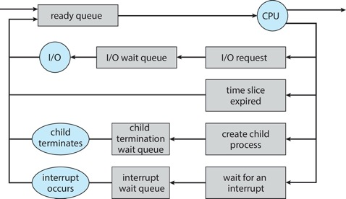
Ready Queue
PCBs move from queue to queue as they change state
Decisions about which order to remove from queues are scheduling decisions
Many algorithms possible (more on this in a few weeks)

Slide 71
Ready Queue And I/O Device Queues
Process not running ⇒ PCB is in some scheduler queue
Separate queue for each device/signal/condition
Each queue can have different scheduler policy
Ready
Queue
Head
Link
Link
Link
Tail
Registers
Registers
Registers
Other State
PCB₉
Other State
PCB₆
Oher State
PCB₁₆
USB
Unit 0
Head
Tail
Disk
Unit 0
Head
Link
Link
Tail
Registers
Registers
Disk
Unit 2
Other State
PCB₂
Other State
PCB₃
Head
Tail
Ether
Netwk 0
Head
Link
Tail
Registers
Other State
PCB₈

Slide 72

Protection
OS must protect itself from user programs
Reliability: prevent OS from crashing
Security: limit scope of what processes can do
Privacy: limit data each process can access
Fairness: enforce appropriate share of HW
It must protect user programs from one another
Main method is to limit translation from virtual to physical address space

Slide 73
How to Protect Processes from One Another?
Protection of memory
Every process does not have access to all memory
Protection of I/O devices
Every process does not have access to every device
Protection of access to processor
Preemptive switching from process to process
Use of timer
Must not be possible to disable timer from user code

Slide 74
Address Translation Maps: Illusion of Separate Address Space
Physical Address Space
Code 2
Stack
Code 1
Stack
Heap
Data 2
Heap
Data
Data 1
Data
Translation Map 1
Translation Map 2
Code
Stack 2
Code
Stack 1
Process 1
Virtual Address Space 1
Heap 2
Process 2
Virtual Address Space 2
Heap 1
OS code
OS data
OS heap &
Stacks

Slide 75
Putting it Together: Process
(Unix) Process
A(int tmp) {
if (tmp<2)
B();
printf(tmp);
}
B() {
C();
}
C() {
A(2);
}
A(1);
…
Memory
Stack
Resources
Sequential stream of instructions
I/O State
(e.g., file, socket contexts)
CPU state (PC, SP, registers..)
Stored in OS

Slide 76
Putting it Together: Processes
Process 1
Process 2
Process N
Switch overhead: high
CPU state: low
Memory/IO state: high
Process creation: high
Protection
CPU: yes
Memory/IO: yes
Sharing overhead: high (involves at least one context switch)
Mem.
Mem.
Mem.
IO
state
IO
state
…
IO
state
CPU
state
CPU
state
CPU
state
CPU scheduler
OS
1 process at a time
CPU
(1 core)

Slide 77
Putting it Together: Threads
Process 1
Process N
threads
threads
Switch overhead: medium
CPU state: low
Thread creation: medium
Protection
CPU: yes
Memory/IO: no
Sharing overhead: low(ish) (thread switch overhead low)
Mem.
Mem.
…
IO
state
…
…
IO
state
CPU
state
CPU
state
CPU
state
CPU
state
CPU scheduler
OS
1 thread at a time
CPU
(1 core)

Slide 78
Putting it Together: Multi-cores
Process 1
Process N
threads
threads
Switch overhead: low (only CPU state)
Thread creation: low
Protection
CPU: yes
Memory/IO: no
Sharing overhead: low (thread switch overhead low, may not need to switch at all!)
Mem.
Mem.
…
IO
state
…
…
IO
state
CPU
state
CPU
state
CPU
state
CPU
state
CPU scheduler
OS
4 threads at a time
Core 1
Core 2
Core 3
Core 4
CPU

Slide 79
Hyperthreading
Superscalar Architecture
Multi-processor
Architecture
Fine-grained
Multithreading
Simultaneous
Multithreading
Colored blocks show executed instructions
Thread 1
Thread 2
Time (cycles)
Superscalar processors can execute multiple instructions that are independent
Multiprocessors can execute multiple independent threads
Fine-grained multithreading executes two independent threads by switches between them
Hyperthreading duplicates register state to make second (hardware) “thread” (virtual core)
From OS’s point of view, virtual cores are separate CPUs
OS can schedule as many threads at a time as there are virtual cores (but, sub-linear speedup!)
See: http://www.cs.washington.edu/research/smt/index.html

Slide 80
Putting it Together: Hyperthreading
Process 1
Process N
threads
threads
Switch overhead between hardware-threads: very-low (done in hardware)
Contention for ALUs/FPUs may hurt performance
Mem.
Mem.
…
IO
state
…
…
IO
state
CPU
state
CPU
state
CPU
state
CPU
state
hardware-threads
(VCores)
CPU scheduler
OS
8 threads at a time
PCore 1
PCore 2
PCore 3
PCore 4
CPU

Slide 81
Dual-mode Operation (4th OS Concept)
Hardware provides at least two modes
Kernel mode (or “supervisor” or “protected”)
User mode, which is how normal programs are executed
How can hardware support dual-mode operation?
Single bit of state (user/system mode bit)
Certain operations/actions only permitted in system/kernel mode
In user mode they fail or trap
User to kernel transition sets system mode AND saves user PC
OS code carefully puts aside user state then performs necessary actions
Kernel to user transition clears system mode AND restores user PC
E.g., rfi: return-from-interrupt

Slide 82
Three Types of Mode Transfer
System call: request for kernel services
E.g., open, close, read, write, lseek
Usually implemented by calling trap or syscall instruction
Special instruction is not strictly required; on some systems, processes trigger system calls by executing some instruction with specific invalid opcode
Processor exception: internal, synchronous, hardware event
E.g., divide by zero, illegal instruction, segmentation fault, page fault
Caused by software behavior
Interrupt: external asynchronous event
E.g., timer, disk ready, network
Interrupts can be disabled, exceptions and traps cannot!

Slide 83
Requirements for Safe Mode Transfer
Limited entry into kernel
HW must ensure entry point into kernel is one set up by kernel
User programs cannot be allowed to jump to arbitrary locations in kernel
Atomic changes to processor state
In user mode, PC and SP point to memory locations in user process
In kernel mode, PC and SP point to memory locations in kernel
Mode, PC, SP, and memory protection should all change atomically
Transparent, restartable execution
User-level process could get interrupted between any two instructions
OS must restore state of user process exactly as it was before interrupt

Slide 84
Interrupt Vector Table
Table set up by OS pointing to code to run on system calls, processor exceptions, and interrupts
On x86, vector numbers 0-31 are for different types of processor exceptions (e.g., divide-by-zero)
Vector numbers 32-255 are for different types of interrupts (e.g., timer)
Vector number 64 is for system call handler

Slide 85

Interrupt Stack
User process state should be saved
OS should not save anything on user stack (why?)
Reliability: what if user program’s SP is not valid?
Security: what if other threads in process change kernel’s return address?
Most OSes go one step further and allocate separate kernel interrupt stack (also called kernel stack) for each user-level thread
PCB could store pointer to kernel stack
memegenerator.net

Slide 86
Two-stack Model Example
Running
Handling syscall
Ready to run
main
main
main
Proc1
Proc1
Proc1
User stack
Proc2
Proc2
Proc2
syscall
syscall
user CPU state
user CPU state
syscall handler
Kernel stack
I/O driver

Slide 87
Interrupt Masking
Interrupt handler runs with interrupts disabled
This simplifies interrupt handling
Interrupts are re-enabled when interrupt completes
Interrupts are deferred (masked) not ignored
HW buffers new interrupts until interrupts are re-enabled
If interrupt are disabled for long time, some interrupts may be lost
On x86, cli disables interrupts and sti enables interrupts
Only applies to current CPU (on a multicore)
User programs cannot use these instructions (why?)
Notes:
Instructions to enable or disable interrupts must be privileged

Slide 88
Mode Transfer Steps in x86
Mask interrupts
Save PS, SP, and execution flags in temporary HW registers
Switch onto kernel interrupt stack (specified in special HW register)
Push the three key values onto interrupt stack
Optionally save an error code
Invoke interrupt handler

Slide 89
Example: x86 Mode Transfer
Kernel
handler() {
pushad;
…
}
Processor Registers
PC
SP
Kernel stack
foo() {
while (…) {
x = x + 1;
y = y – 2;
}
}
EFLAGS
User-level process
Other Regs EAX, EXB,
…
User stack
foo
…

Slide 90
Example: x86 Mode Transfer (cont.)
Kernel
Single instruction to
Save some registers (e.g., SP, PC)
Change PC and SP
Switch Kernel/user mode
handler() {
pushad;
…
}
Processor Registers
PC
SP
Kernel stack
foo() {
while (…) {
x = x + 1;
y = y – 2;
}
}
EFLAGS
User-level process
Other Regs EAX, EXB,
…
Error
User stack
PC
foo
EFLAGS
…
SP

Slide 91
Example: x86 Mode Transfer (cont.)
Kernel
Single instruction to save all registers
Why is stack pointer saved twice?
Hint: are they the same?
handler() {
pushad;
…
}
Processor Registers
PC
SP
Kernel stack
foo() {
while (…) {
x = x + 1;
y = y – 2;
}
}
EFLAGS
User-level process
Other Regs EAX, EXB,
…
…
EXB
EXA
SP
All Regs
Error
User stack
PC
foo
EFLAGS
…
SP

Slide 92
Example: System Call Handler
Vector through well-defined system call entry points!
Table mapping system call number to handler
Locate arguments
In registers or on user (!) stack
Copy arguments (copy before check)
From user memory into kernel memory
Protect kernel from malicious code evading checks
Validate arguments
Protect kernel from errors in user code
Copy results back
Into user memory

Slide 93
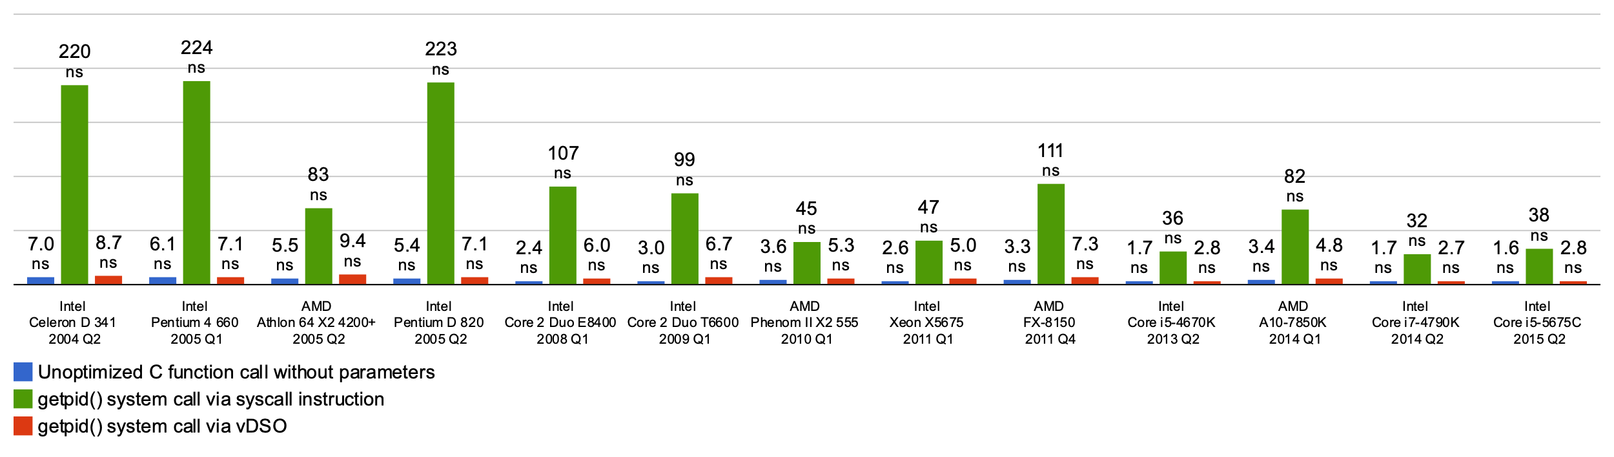
Basic Cost of System Calls
Min syscall has ~ 25x cost of function call
Linux vDSO (virtual dynamic shared object) runs some system calls in user space
E.g., gettimeofday or getpid

Slide 94
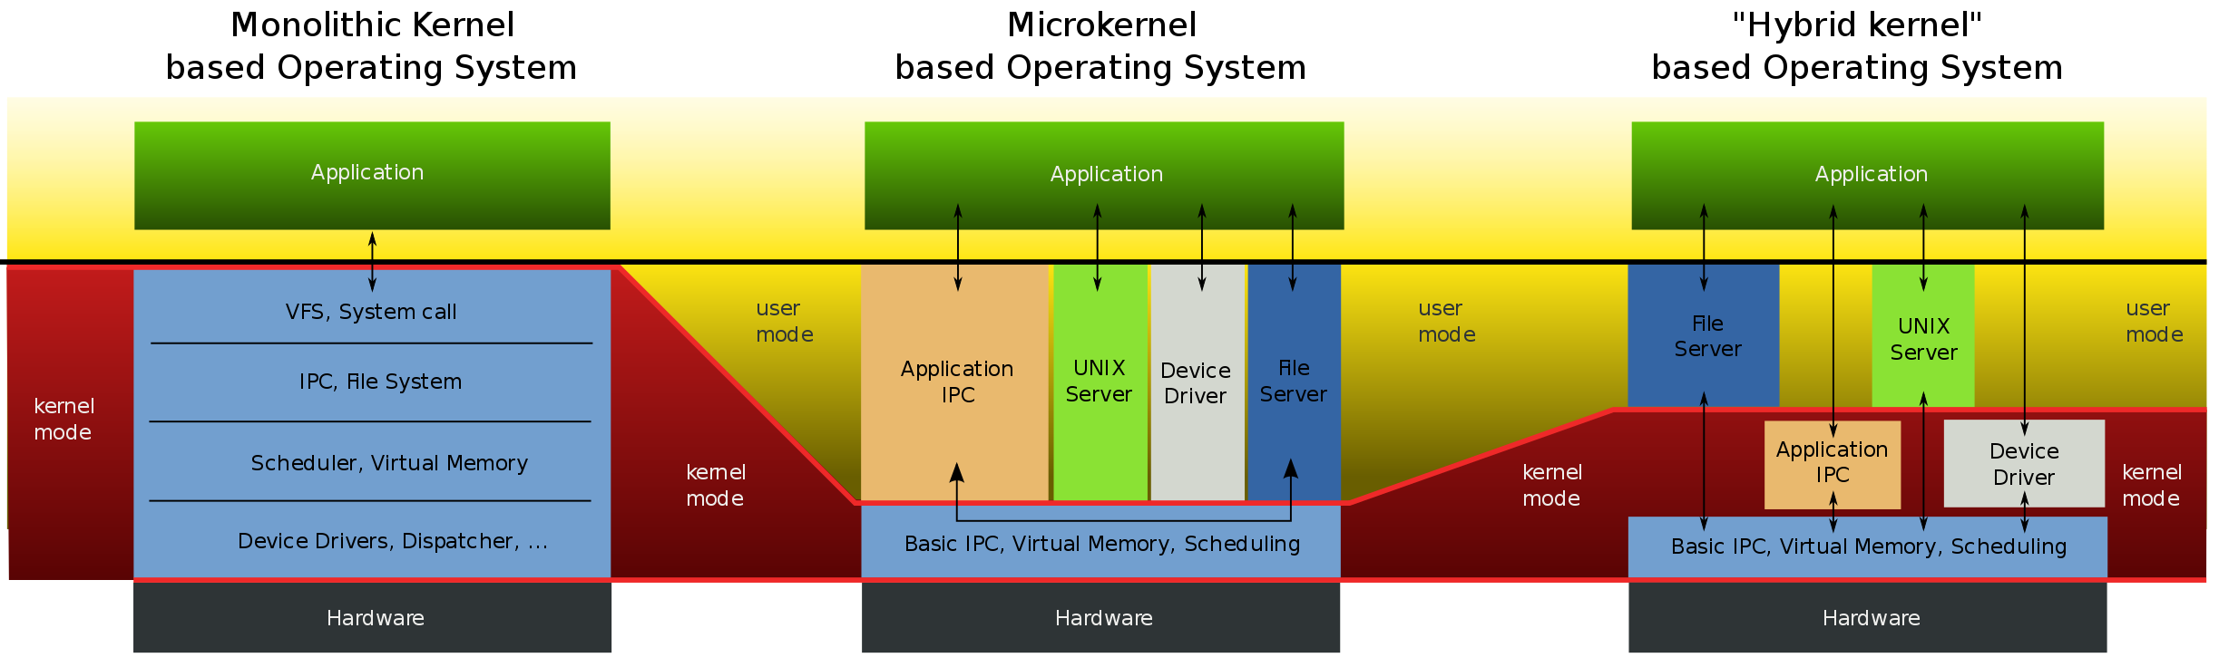
Aside: Monolithic vs Microkernel OS
Users
Operating
system
en.wikipedia.org

Slide 95
Aside: Influence of Microkernels
Microkernels provide better modularity, security, and fault tolerance, but they introduce higher communication overhead
Too many context switches
Many OSes provide some services externally, like microkernels
OS X and Linux: windowing (graphics and UI)
Some currently monolithic OSes started as microkernels
Windows family originally had microkernel design
OS X is hybrid of Mach microkernel and FreeBSD monolithic kernel

Slide 96
Kernel to User Mode Switch Examples
New process/new thread start
Jump to first instruction in program/thread
Return from interrupt, exception, system call
Resume suspended execution
Process/thread context switch
Resume some other process
User-level upcall (UNIX signal)
Asynchronous notification to user program
Preemptive user-level threads
Asynchronous I/O notification
Interprocess communication
User-level excepting handling
User-level resource allocation

Slide 97
Example: User/Kernel Mode Transfers
User Mode
rtn
interrupt
exception
syscall
rfi
Kernel Mode
exit
exec
Hardware
Limited HW access
Full HW access

Slide 98

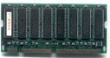
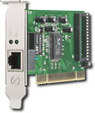
System Call Interface: Access Point to Hardware Resources
The System Call Interface
Process
Management
Memory Management
Filesystems
Device Control
Networking
Concurrency, multitasking
Virtual memory
Files and dirs: the VFS
TTYs and device access
Connectivity
Architecture
Dependent
Code
Memory Manager
File System Types
Device Control
Network Subsystem
Block Devices
IF drivers

Slide 99
Device Drivers
Device-specific code in kernel that interacts directly with device hardware
Supports standard, internal interface
Same kernel I/O system can interact easily with different device drivers
Special device-specific configuration supported with ioctl() syscall
Device drivers are typically divided into two pieces
Top half: accessed in call path from system calls
implements a set of standard, cross-device calls like open(), close(), read(), write(), ioctl(), etc.
This is kernel’s interface to device driver
Top half will start I/O to device, may put thread to sleep until finished
Bottom half: run as interrupt routine
Gets input or transfers next block of output
May wake sleeping threads if I/O now complete

Slide 100
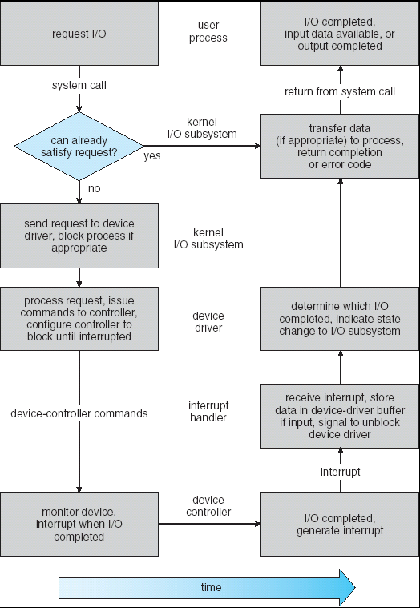
Life Cycle of an I/O Request
User
Program
Kernel I/O
Subsystem
Device Driver
Top Half
Device Driver
Bottom Half
Device
Hardware

Slide 101
I/O Data Transfer
Programmed I/O
Each byte transferred via processor in/out or load/store
+ Simple hardware, easy to program
− Consumes processor cycles proportional to data size
Direct memory access (DMA)
Give controller access to memory bus
Ask it to transfer data blocks to/from memory directly

Slide 102
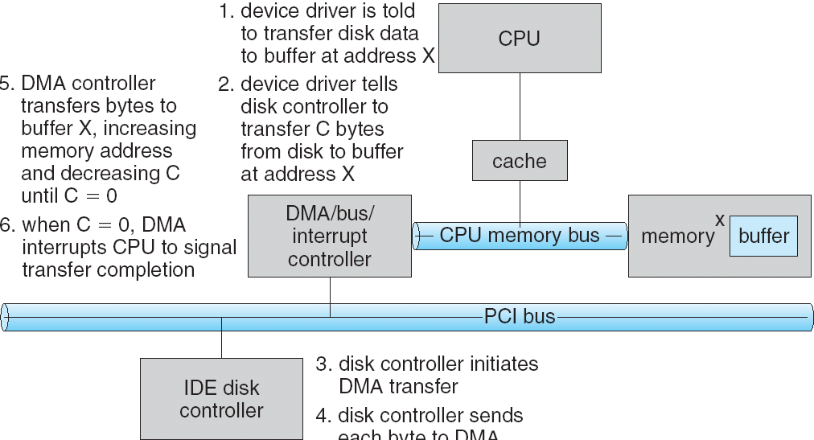
DMA Transfer
1
6
5
2
4
3
Device driver is told to transfer disk data to buffer at address x
Device driver tells disk controller to transfer C bytes from disk to buffer at address x
Disk controller initiates DMA transfer
Disk controller send each byte to DMA controller
DMA controller transfers bytes to buffer x, increasing address and decreasing C
When C = 0, DMA interrupts CPU to signal transfer completion

Slide 103
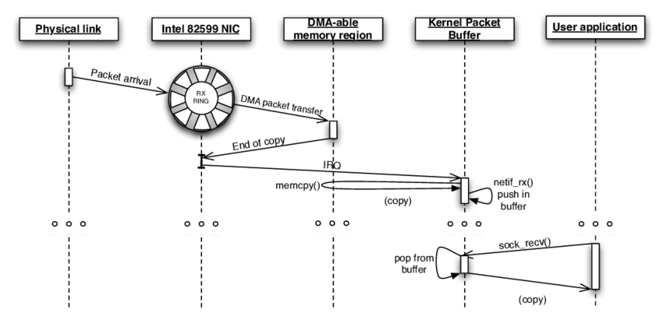
DMA Example: Network Stack in Linux Kernels before 2.6
García-Dorado, José Luis, et al. "High-performance network traffic processing systems using commodity hardware." Data traffic monitoring and analysis. Springer, Berlin, Heidelberg, 2013. 3-27.

Slide 104

How Does Kernel Provide Services?
You said that applications request services from OS via syscall, but …
I’ve been writing all sorts of applications, and I never ever saw a “syscall” !!!
That’s right!
It was buried in the programming language runtime library (e.g., libc.a)
… Layering

Slide 105









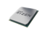
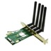
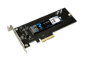
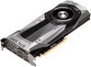
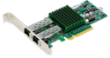
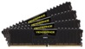


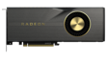
OS Run-time Library
Proc 1
Proc 2
…
Proc n
OS
Proc 1
Proc 2
Proc n
…
OS Library
OS Library
OS Library
OS

Slide 106
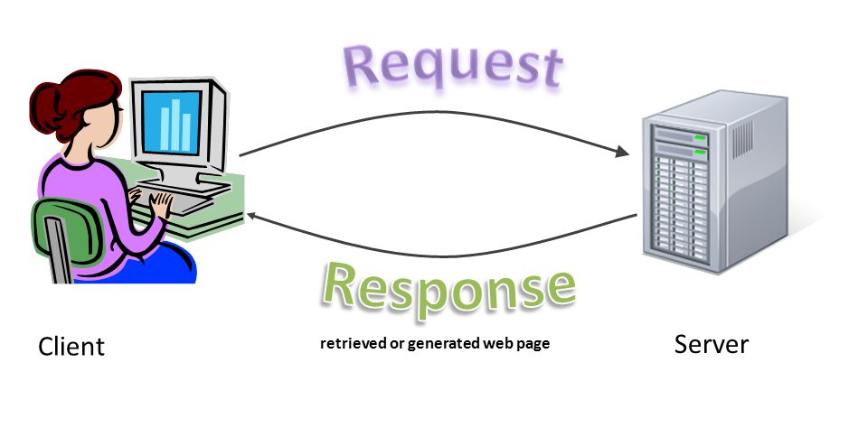
Putting it Together: Web Server
Request
Reply
(retrieved by web server)
Client
Web Server

Slide 107
Putting it Together: Web Server (cont.)
Server
4. parse request
9. format reply
request
buffer
reply
buffer
network
socket
read
3. kernel
copy
10. network
socket
write
5. file
read
8. kernel
copy
syscall
syscall
syscall
Kernel
wait
RTU
11. kernel copy
from user buffer
to network buffer
RTU
interrupt
interrupt
2. copy arriving
packet (DMA)
12. format outgoing
packet and DMA
6. disk
request
7. disk data
(DMA)
Hardware
Network
interface
Disk interface
Request
Reply

Slide 108
Summery
Thread
Single unique execution context which fully describes program state
Program counter, registers, execution flags, stack
Address space (with translation)
Address space which is distinct from machine’s physical memory addresses
Process
Instance of executing program consisting of address space and 1+ threads
Dual-mode operation/protection
Only “system” can access certain resources
OS and hardware are protected from user programs
User programs are isolated from one another by controlling translation from program virtual addresses to machine physical addresses

Slide 109

Questions?
globaldigitalcitizen.org

Slide 110
Acknowledgment
Slides by courtesy of Anderson, Culler, Stoica, Silberschatz, Joseph, Zarnett, and Canny

